Slide 1
ECSE-211 Design Principles and Methods
Lecture: Design 1
11 January 2019

Slide 2
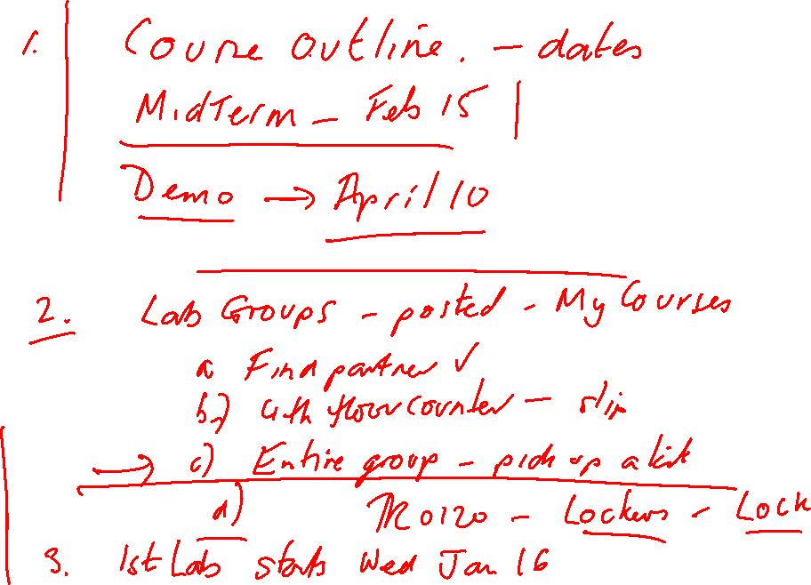

Slide 3
Introduction to Design

Slide 4
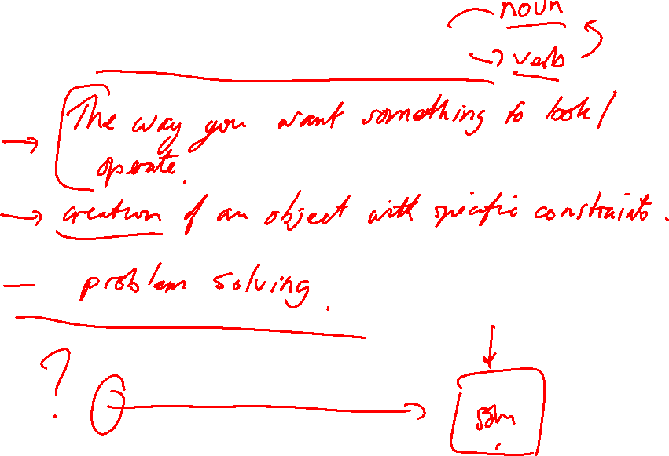
What is Design?

Slide 5
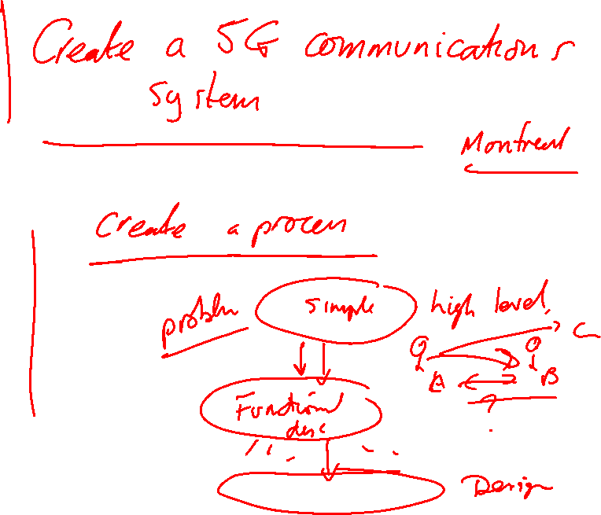

Slide 6
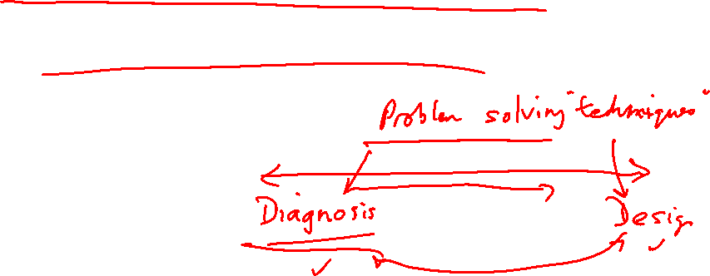
Problem Solving
Design is a problem solving exercise..
How do you solve problems?

Slide 7
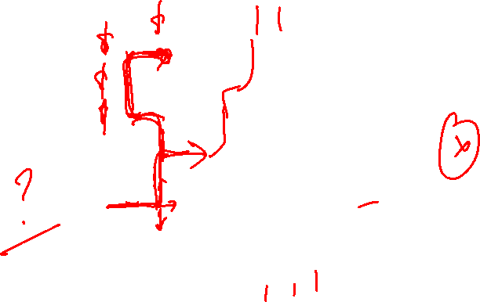
Design
Getting to the solution of a design problem is like solving a maze…

Slide 8

Design
Getting to the solution of a design problem is like solving a maze…
But it is a maze with several entrances and several exits…

Slide 9
Design
Engineering involves solving a presented problem – could be design, could be diagnosis
Problem solving requires a formal process…

